Slide 1
Attention Is All You Need - Transformers
Machine language translation using Transformer networks

Slide 2
The Paper
The research paper titled Attention is All You Need was published in 2017 in NeurIPS, and since it has been cited more than 60K times.
This architecture is now considered as a base model for tasks such as machine translation, sentiment analysis, text generation etc.
The Transformer uses attention mechanism, and also employs an encoder and decoder, but removing recurrence in favor of attention mechanisms allows for significantly more parallelization than methods like RNNs and CNNs.

Slide 3
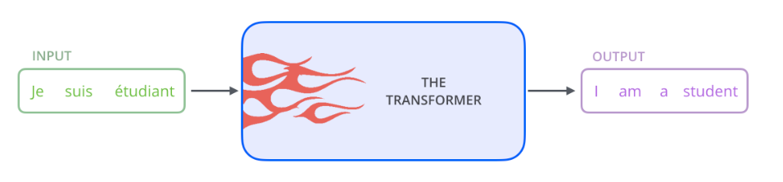
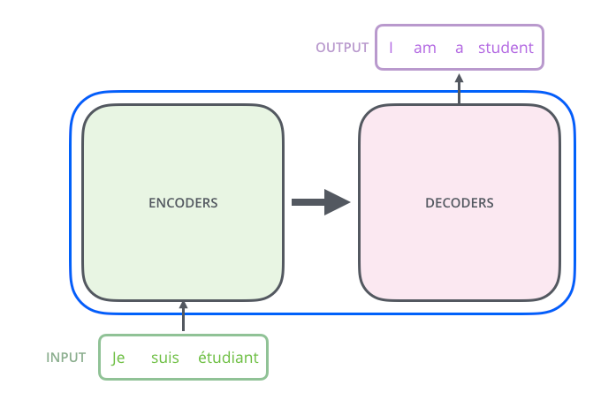
Basic Transformer
For machine translation application, it takes a sentence in one language, and outputs it in another language.
It consists of two an Encoding block, and a Decoding block, with connections between them.

Slide 4


Encoder & Decoder Blocks
Each encoder has a FFNN layer, and a self attention layer.
Decoder has a Encoder-Decoder attention layer in addition to these two.
Encoding block – stack of encoder
Decoder block – stack of decoders

Slide 5
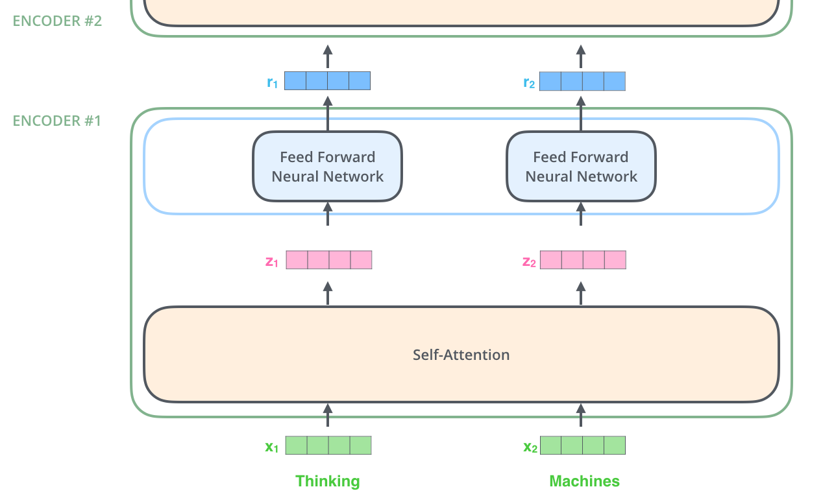

Inside the Encoder
1) Turn words to vectors using word embedding technique – word2vec
2) Pass the vectors parallelly to self attention layer
3) Get the self attention layer outputs and pass to separate FFNN layers.
What is Self Attention Layer
Helps the encoder look at other words in the input sentence as it encodes a specific word
As the model processes each word (each position in the input sequence), self attention allows it to look at other positions in the input sequence for clues that can help lead to a better encoding for this word.
”The animal didn't cross the street because it was too tired”

Slide 6

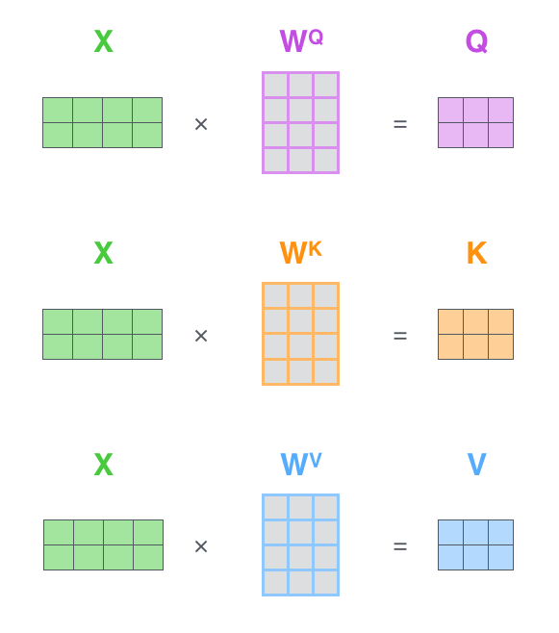

Calculating Self Attention

Slide 7
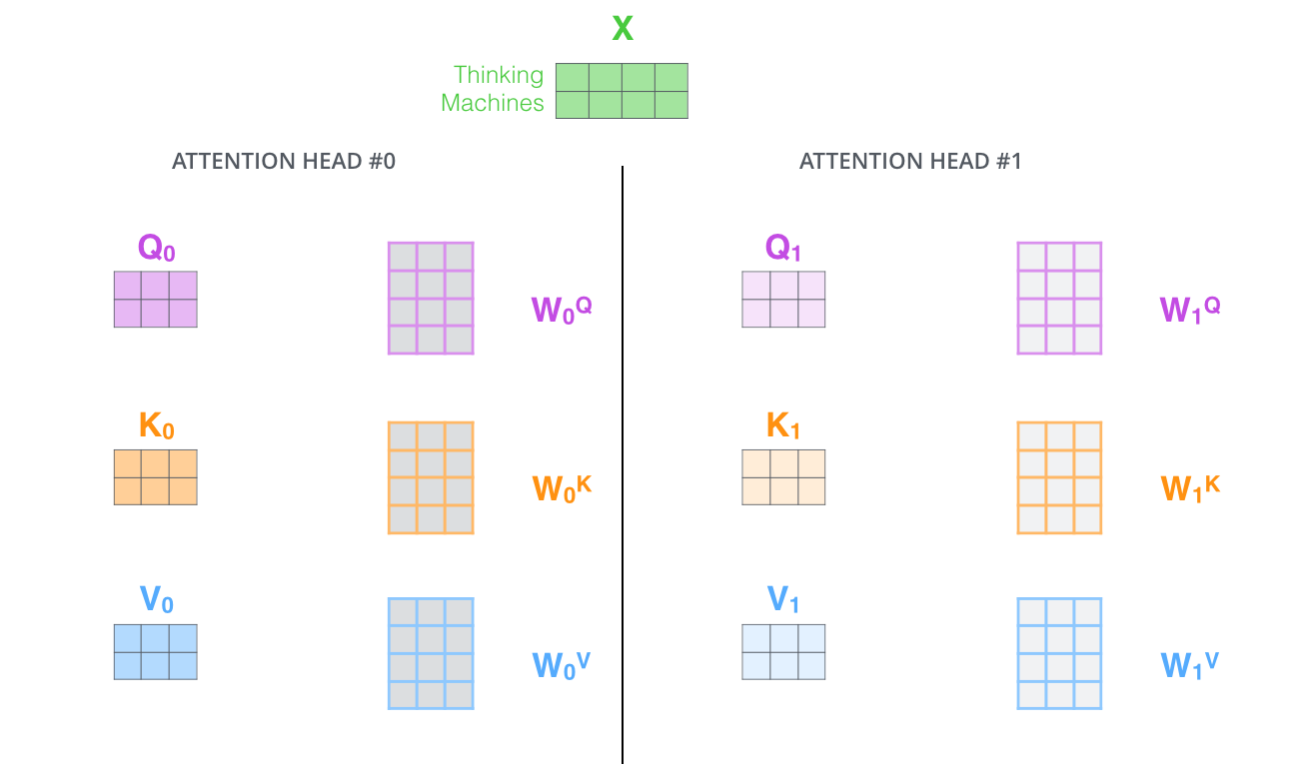
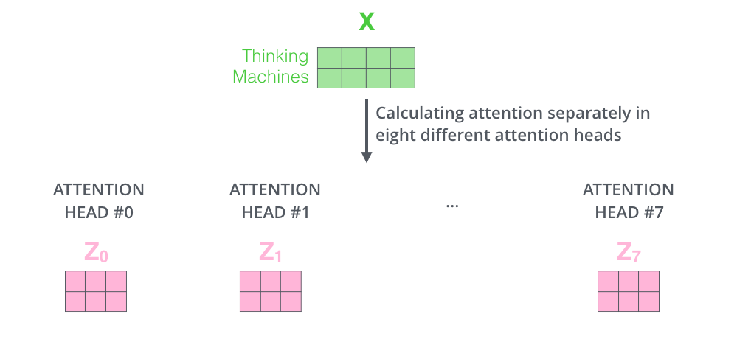
Multi-Headed Attention
It expands the model’s ability to focus on different positions. Yes, in the Single-Headed, z1 contains a little bit of every other encoding, but it could be dominated by the actual word itself.
It gives the attention layer multiple “representation subspaces”. Has multiple sets of Query/Key/Value weight matrices. Then, after training, each set is used to project the input embeddings.

Slide 8

Z from Multi-Head attention

Slide 9
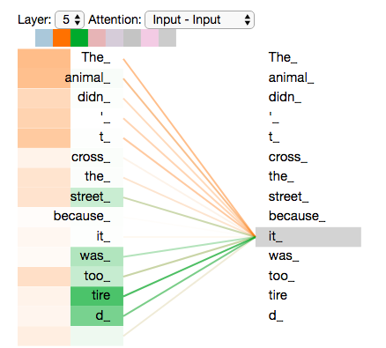
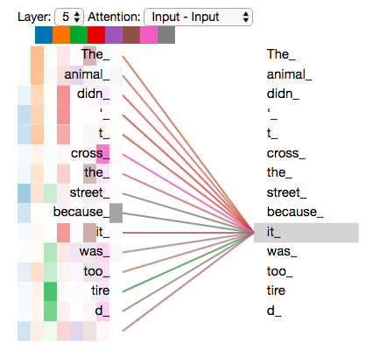
Multi-Headed Self Attention
Different attention heads are focusing on different words in-relation to it.

Slide 10
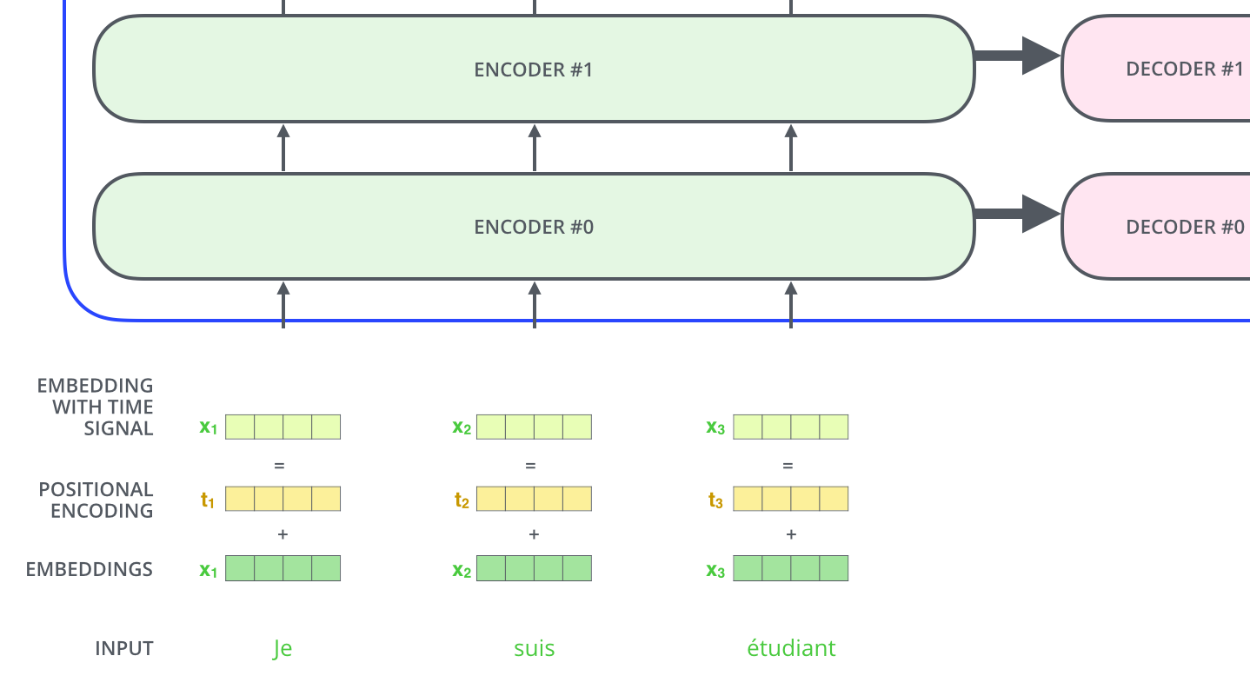
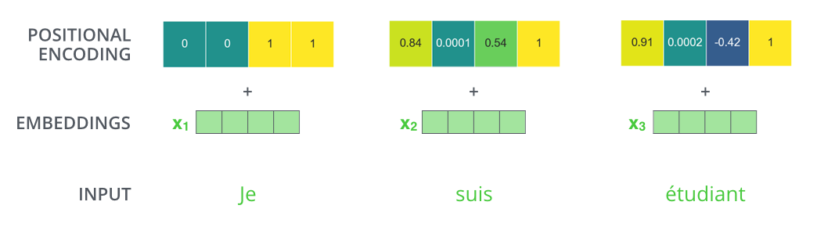
Positional Encoding
Order of Words in Input Sequence ->
Transformer adds a vector to each input embedding. These vectors follow a specific pattern that the model learns, which helps it determine the position of each word, or the distance between different words in the sequence.
The intuition here is that adding these values to the embeddings provides meaningful distances between the embedding vectors once they’re projected into Q/K/V vectors and during dot-product attention.

Slide 11


Residuals & Normalization

Slide 12


Decoder & Output
Output of the top encoder is then transformed into a set of attention vectors K and V. These are to be used by each decoder in its “encoder-decoder attention” layer which helps the decoder focus on appropriate places in the input sequence.
In the decoder, the self-attention layer is only allowed to attend to earlier positions in the output sequence. This is done by masking future positions (setting them to -inf) before the softmax step in the self-attention calculation.

Slide 13
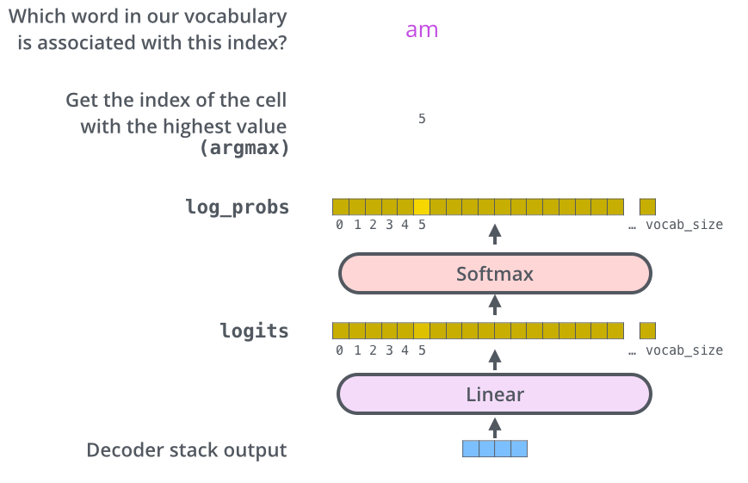
Linear & Softmax

Slide 14
Implementation & Code
Refer Jupyter Notebook.
We used the Multi30k dataset which contains images as well as their annotations in both English and German. We just make use of these annotations for our project.
Also, we used spacy module to load the vocabulary for German & English languages.
The transformer network is implemented by extending the nn.transformer module from PyTorch.

Slide 15
Results
We are able to get a BLEU score of ~29 after 50 epochs, ~35 after 10K epochs of training, with vocabulary size of 10K
A score of 60-70 is considered to be the best SOTA score for machine language translation, which can be achieved after training on vocabulary size of 30k-40k (we didn’t do it because of hardware limitations).

